Slide 1
ZF Diet Inf Results

Slide 2
Questions
Diet
Does diet affect fish physiology?
Does diet affect the microbiome?
Development
Does time link to physiology?
Does time link to microbiome?
How do fish microbiomes develop over time as a function of diet and physiology?
Pathogen Exposure
Does exposure affect the microbiome?
Is the exposure effect on the microbiome diet dependent?

Slide 3
Does diet affect fish physiology?

Slide 4
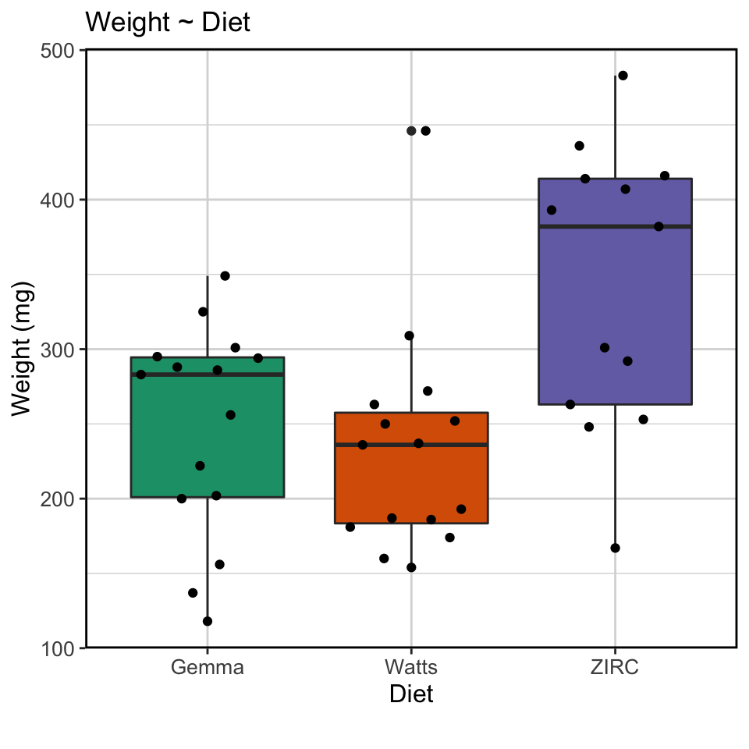
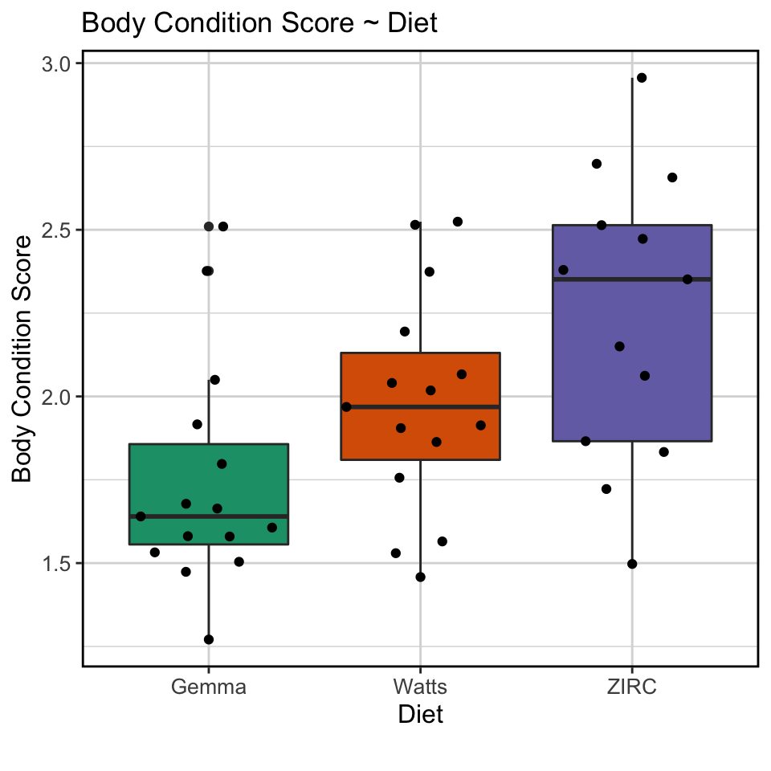
ZIRC diet had higher weight and body condition scores

Slide 5
Does diet link to fish microbiome?

Slide 6
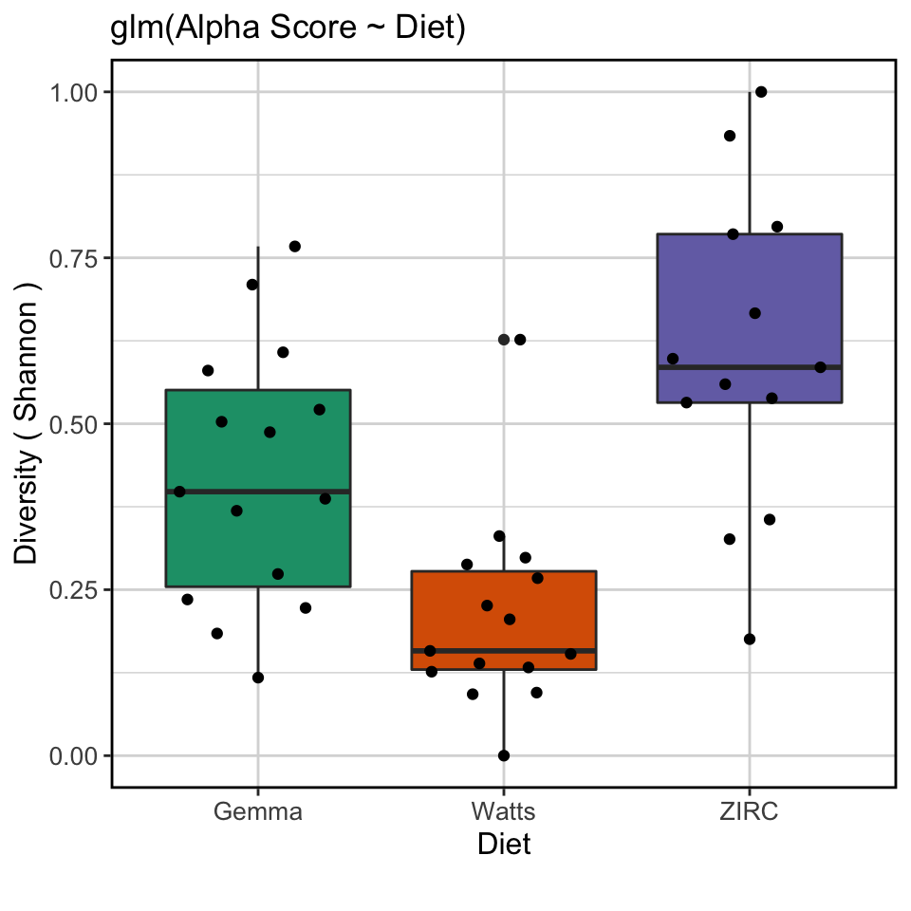
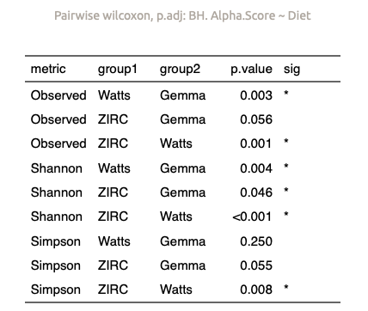
Alpha diversity score stratified by diet with ZIRC having the highest, followed by Gemma and Watts with the lowest
(final timepoint)

Slide 7
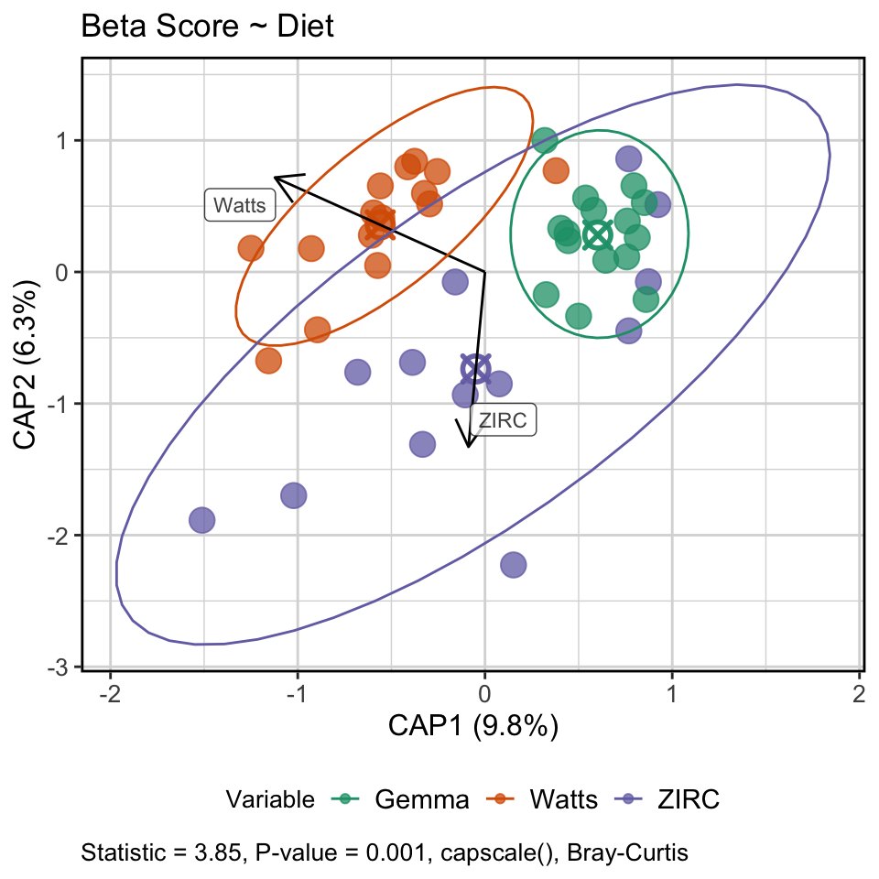
Diet stratifies the composition of the gut microbiome
(final timepoint)

Slide 8
Differentially abundant genera found across diets
(final timepoint)

Slide 9
Does time link to physiology?

Slide 10
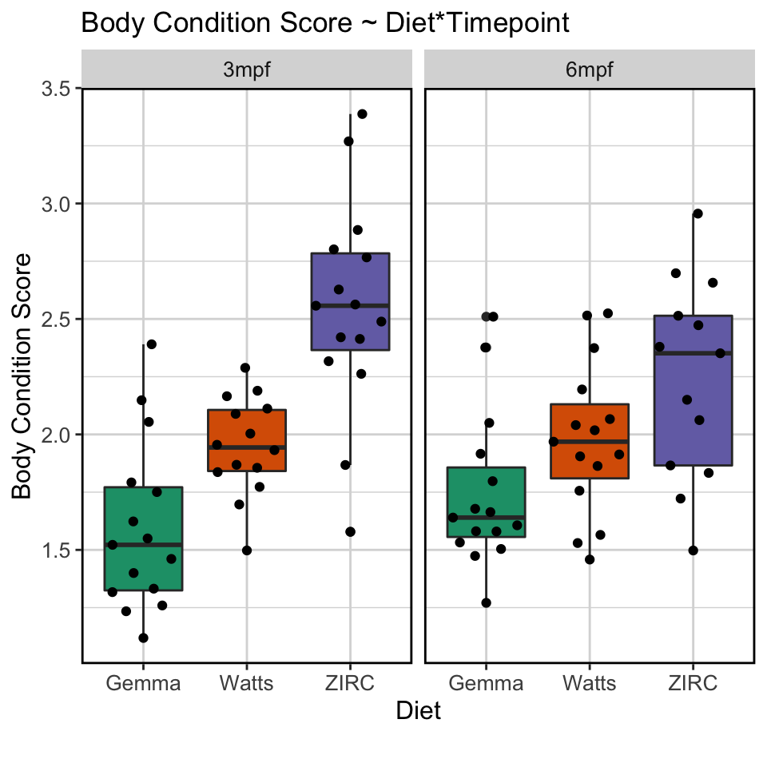
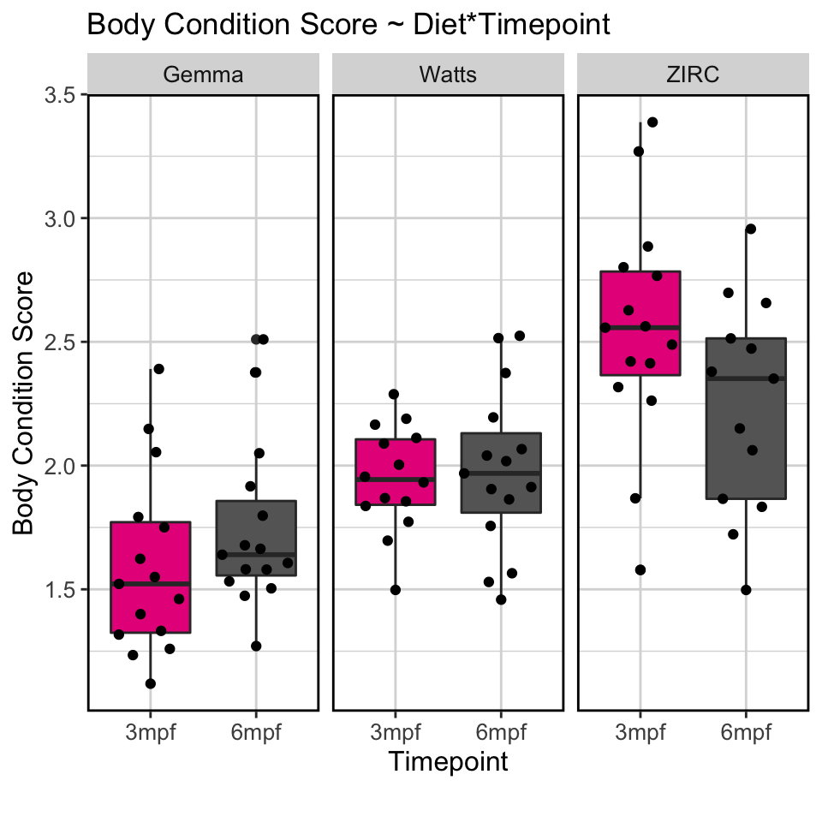
ZIRC fed fish have higher BCS across development, while other diets are more stable

Slide 11
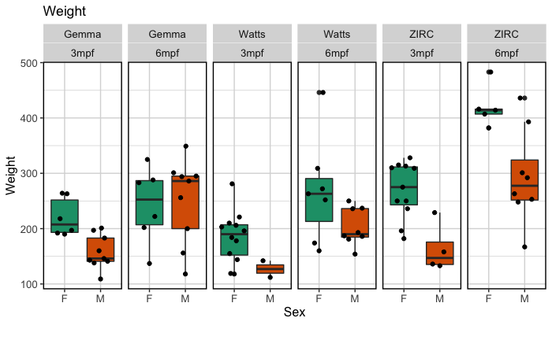
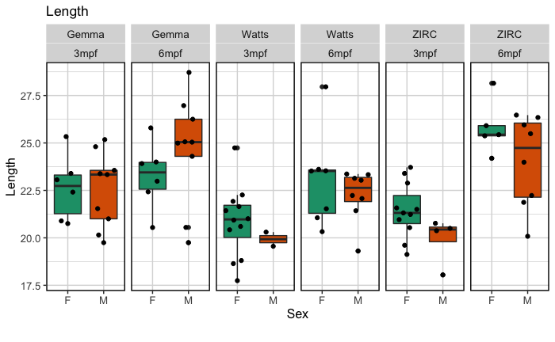
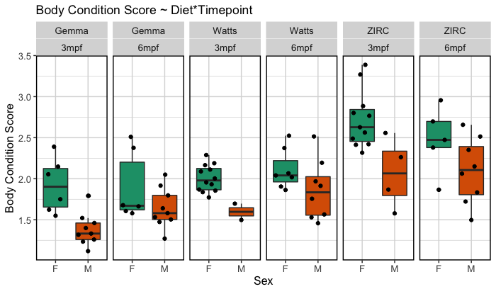
Body.Condition.Score = (Weight/(Length^3)*100)

Slide 12
Does time impact the microbiome?

Slide 13
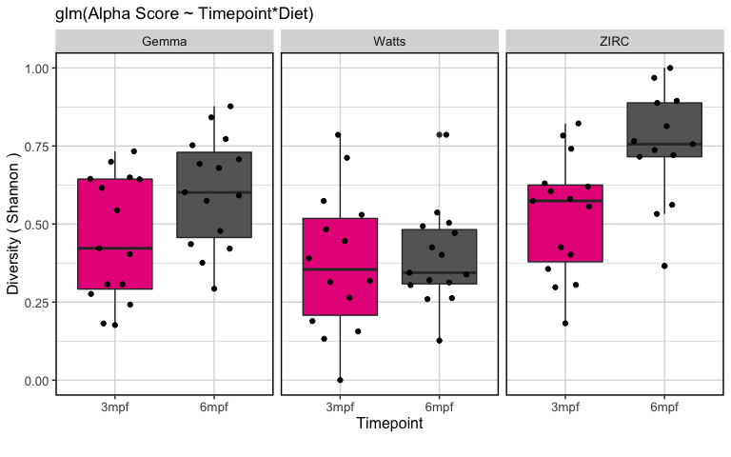
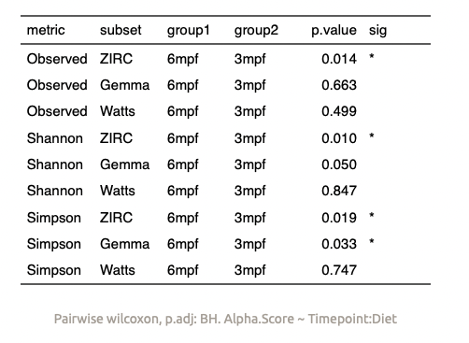
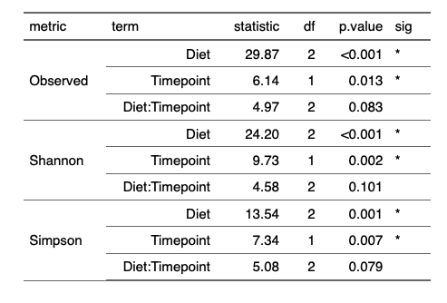
Diet and time associate with diversity, but the interaction effect is weak
Notes:
watts diet is temporally more stable. Gemma and ZIRC increase over time

Slide 14
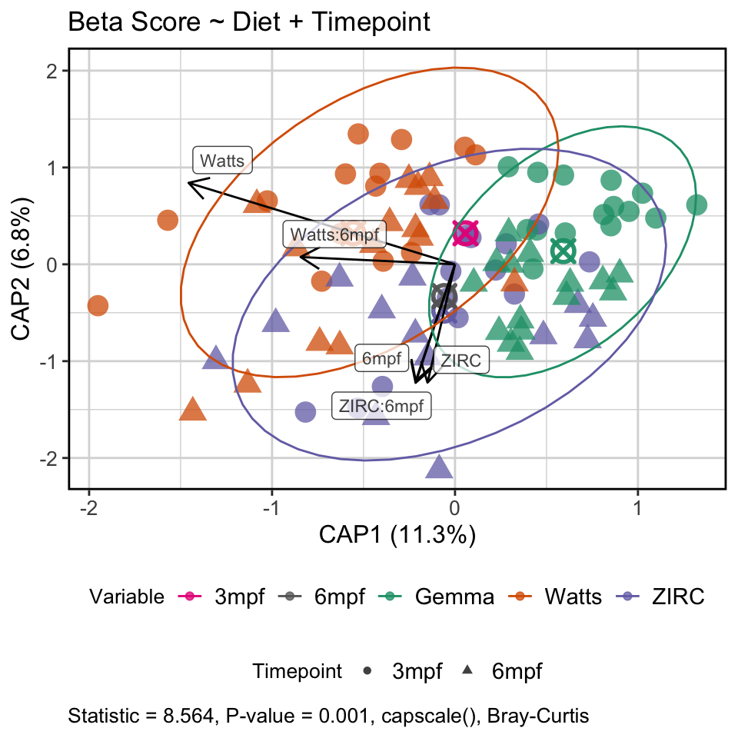
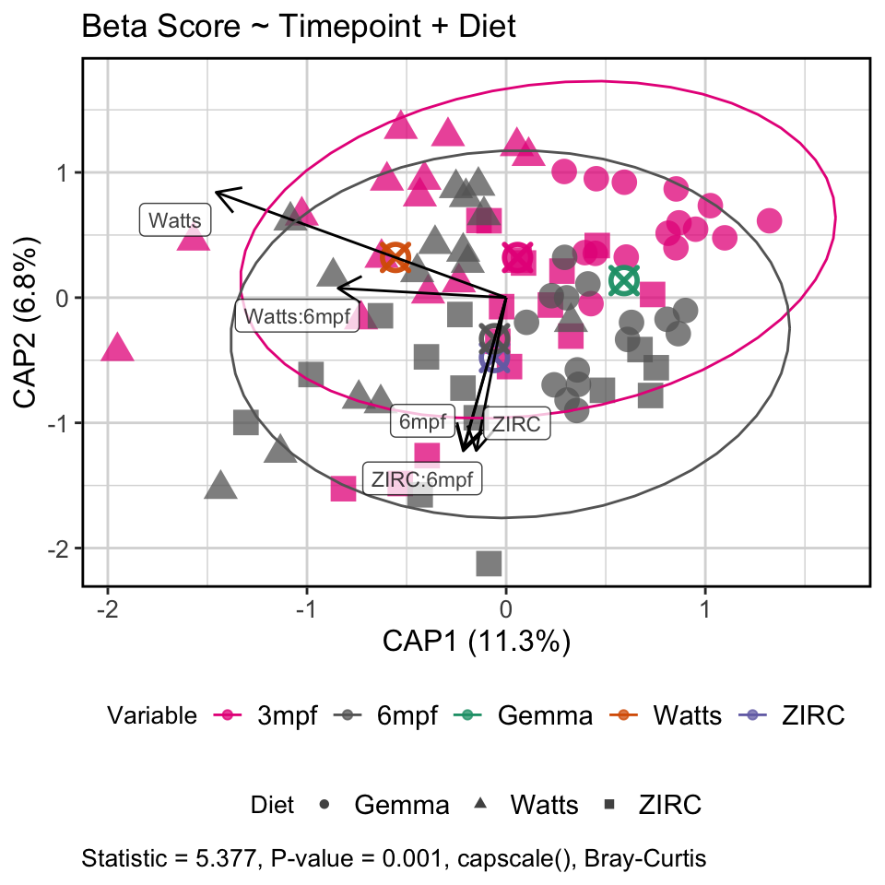
Diet driving abundance of certain taxa, while time influences composition
Notes:
Microbiome composition changes regardless of diet

Slide 15
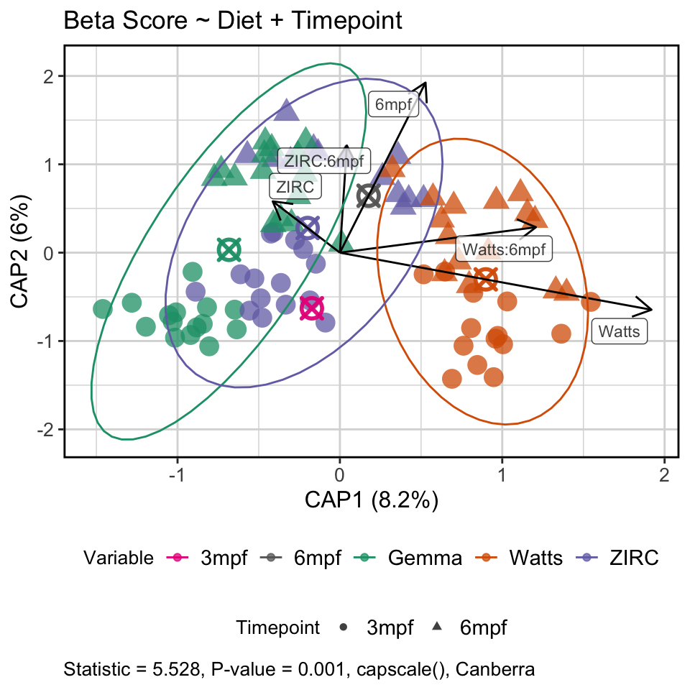
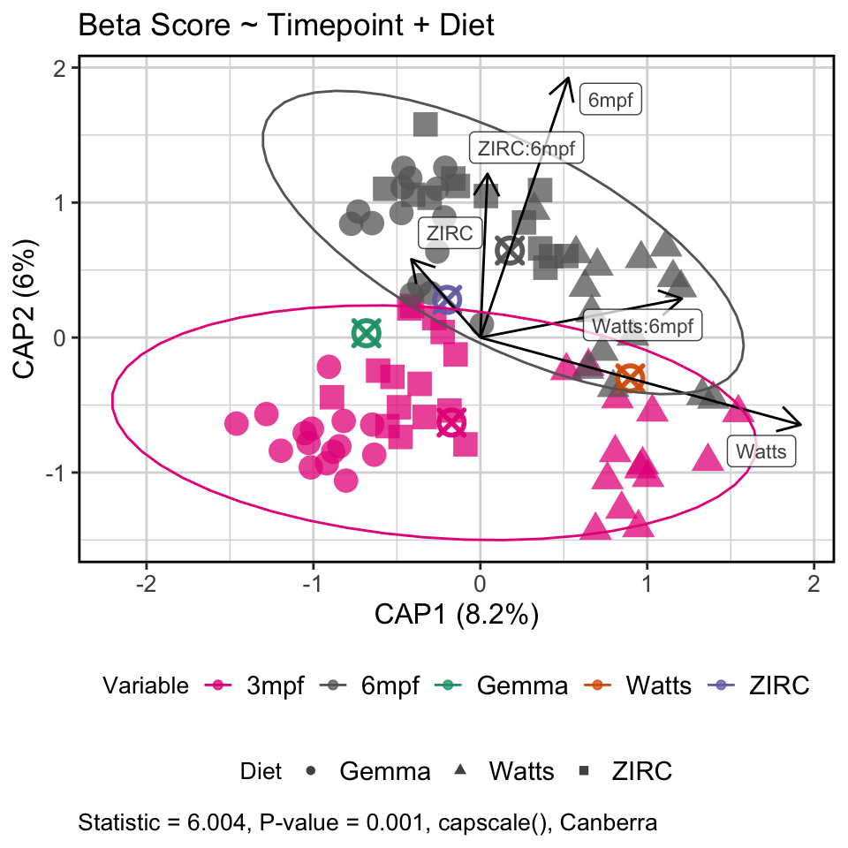
Diet driving abundance of certain taxa, while time influences composition
Notes:
Microbiome composition changes regardless of diet

Slide 16
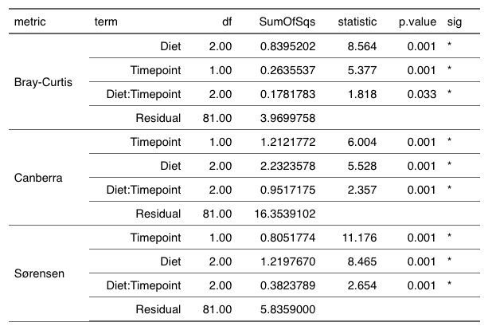

Slide 17
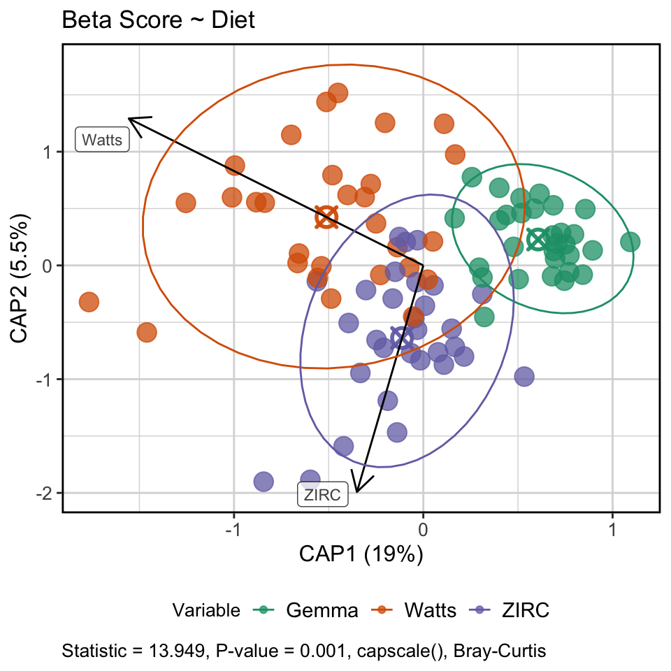
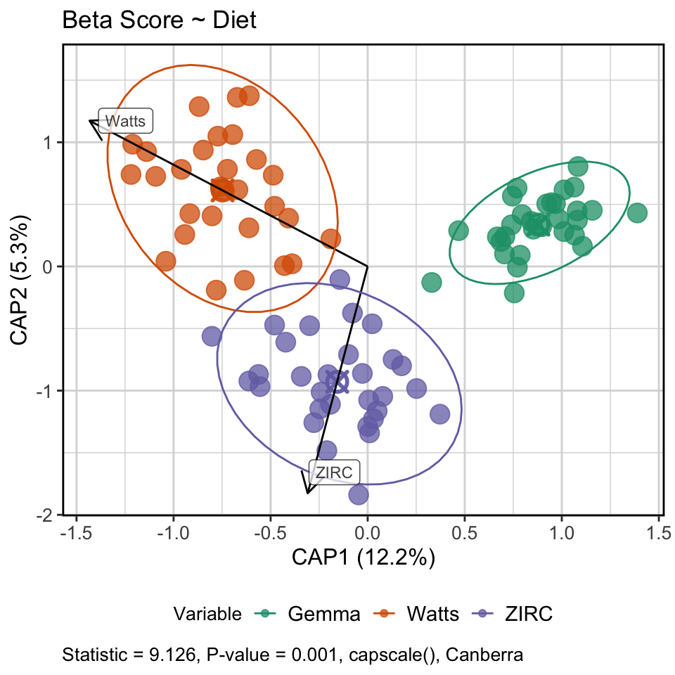
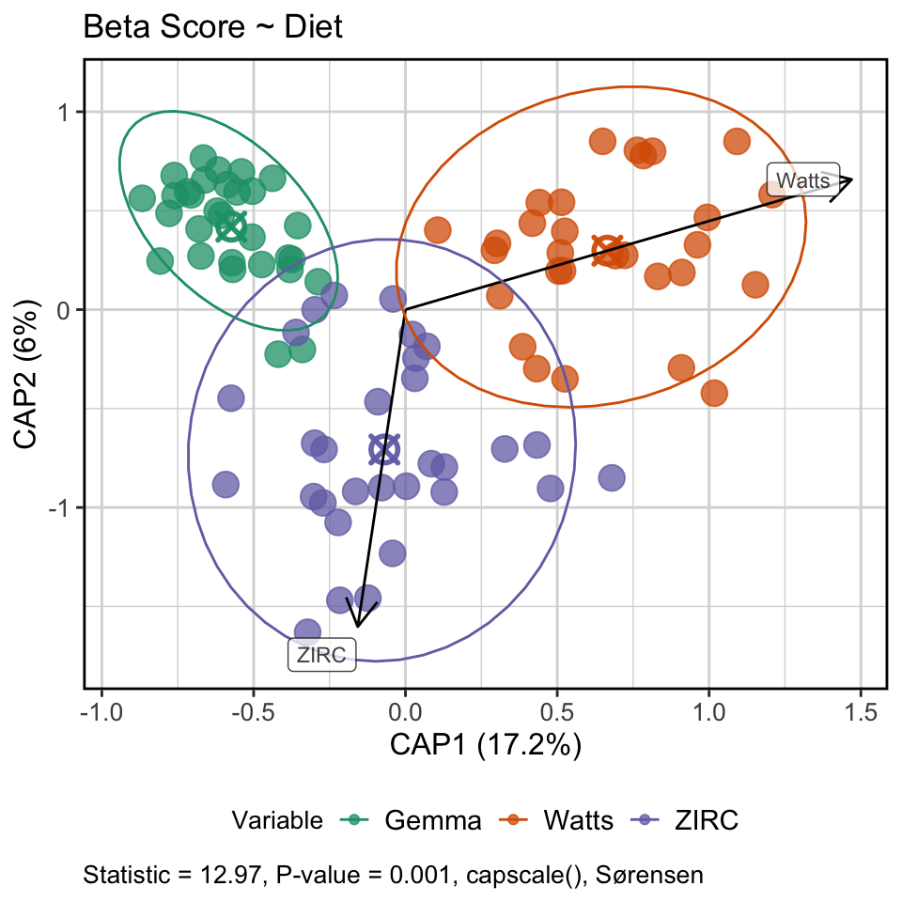
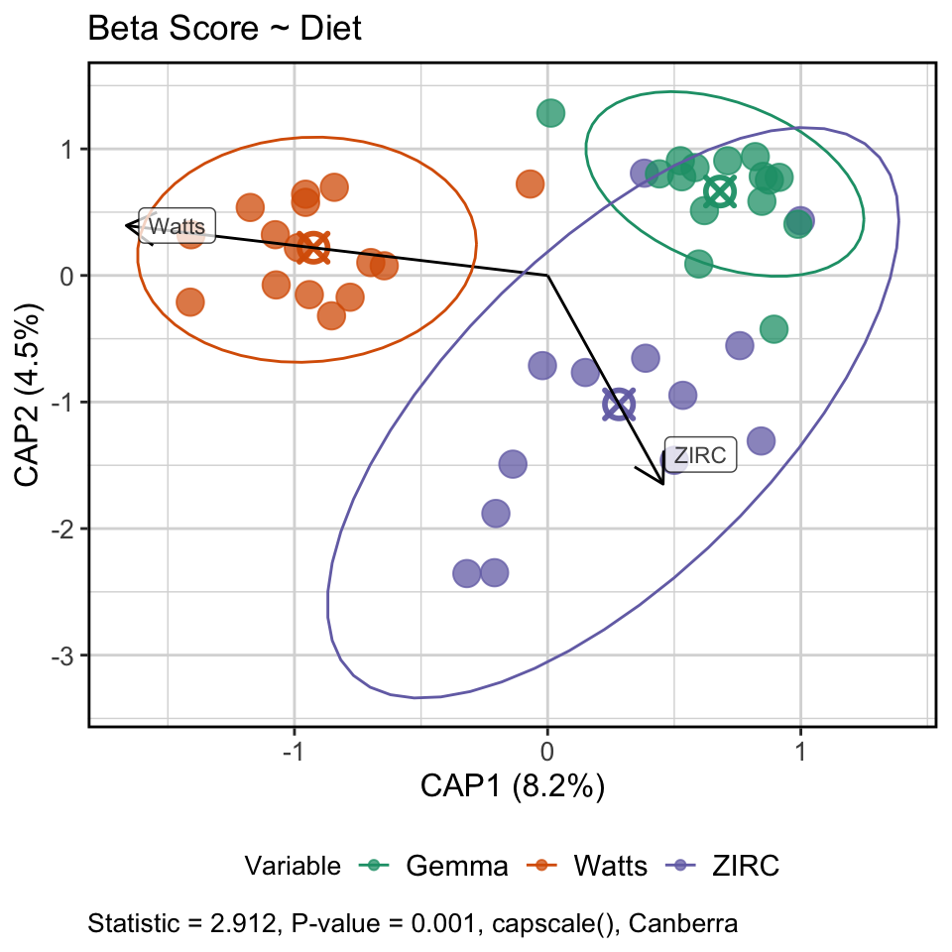
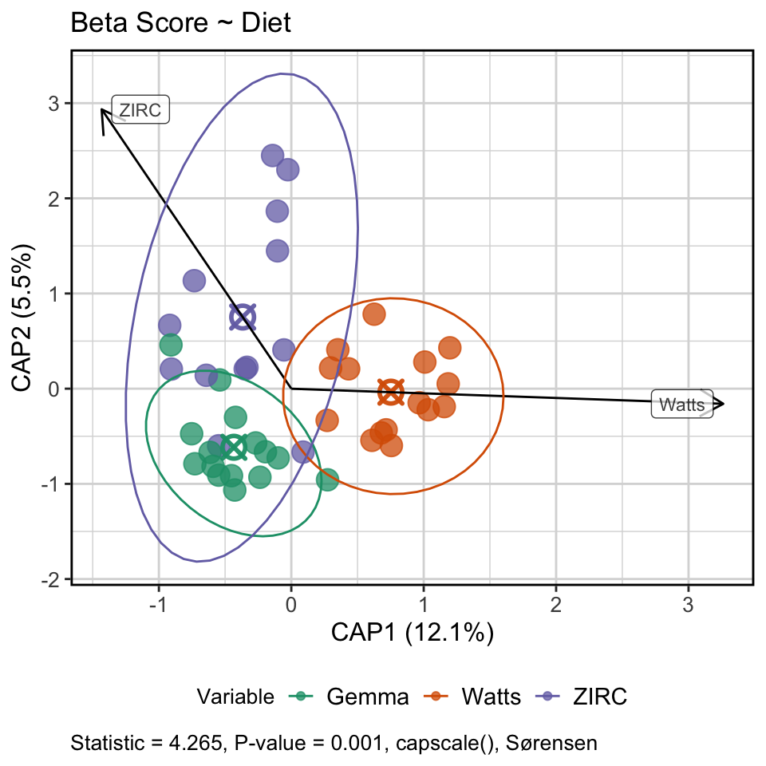
INITIAL
FINAL

Slide 18
How do fish microbiomes develop over time as a function of diet and physiology?

Slide 19
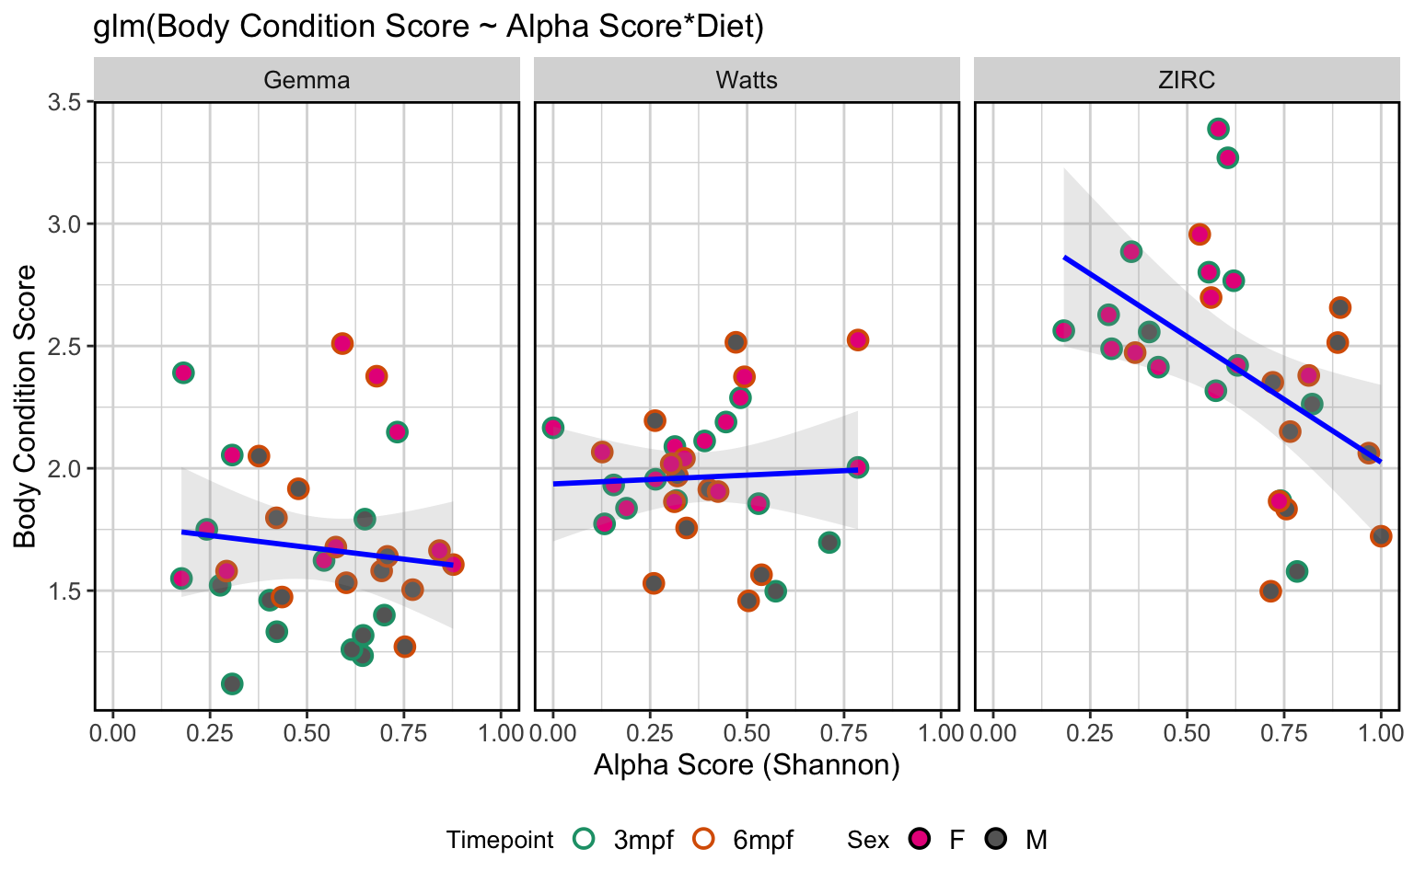
Body condition score decreases as alpha diversity increases in ZIRC fed fish

Slide 20
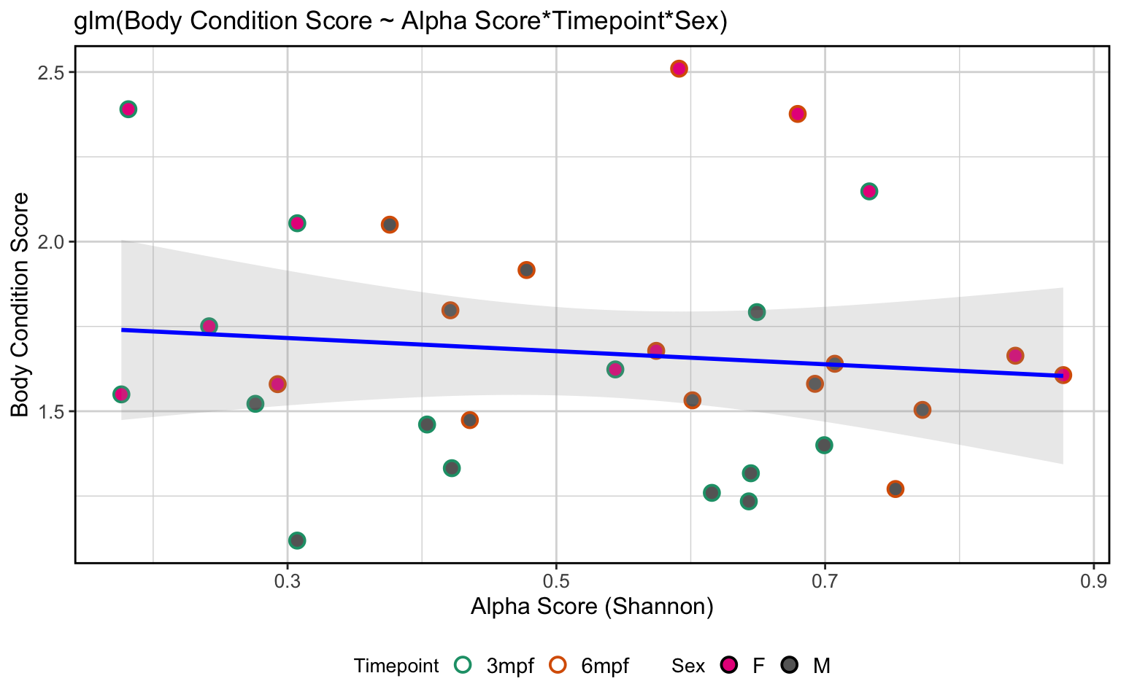
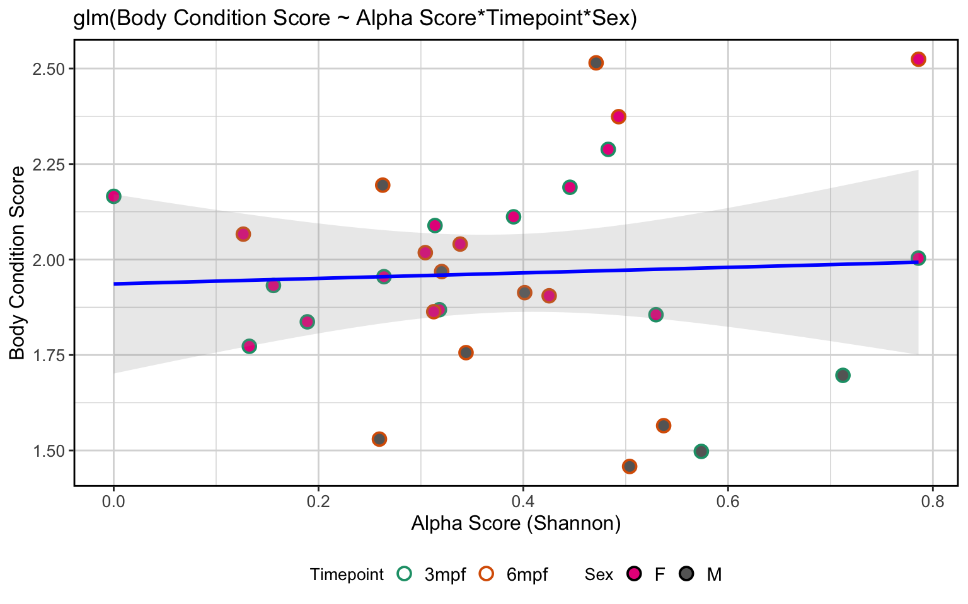
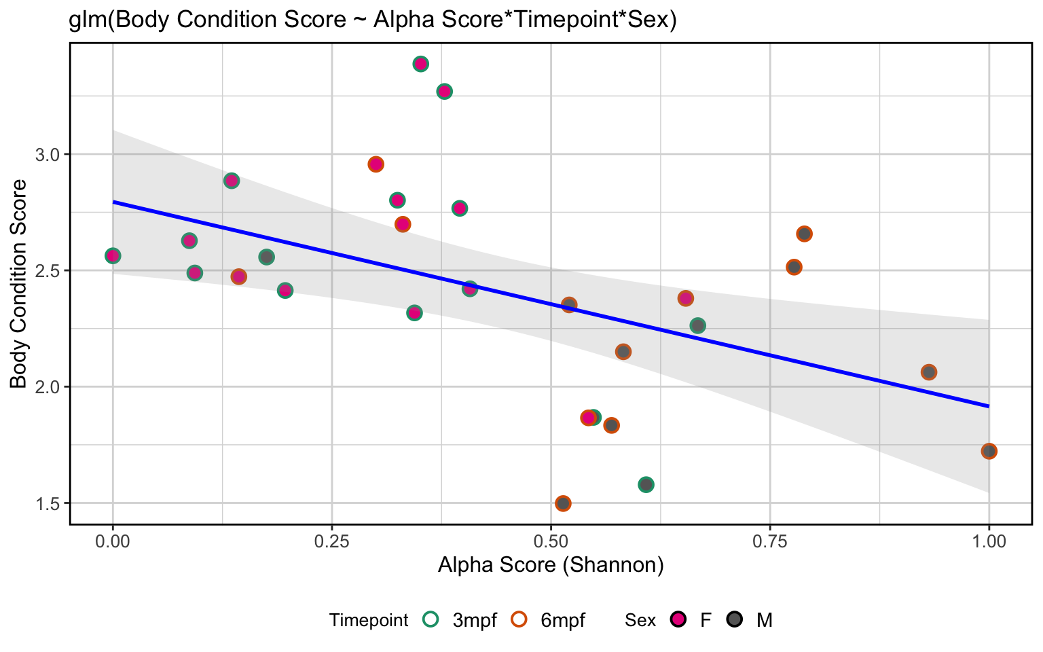
Gemma | Watts
ZIRC

Slide 21
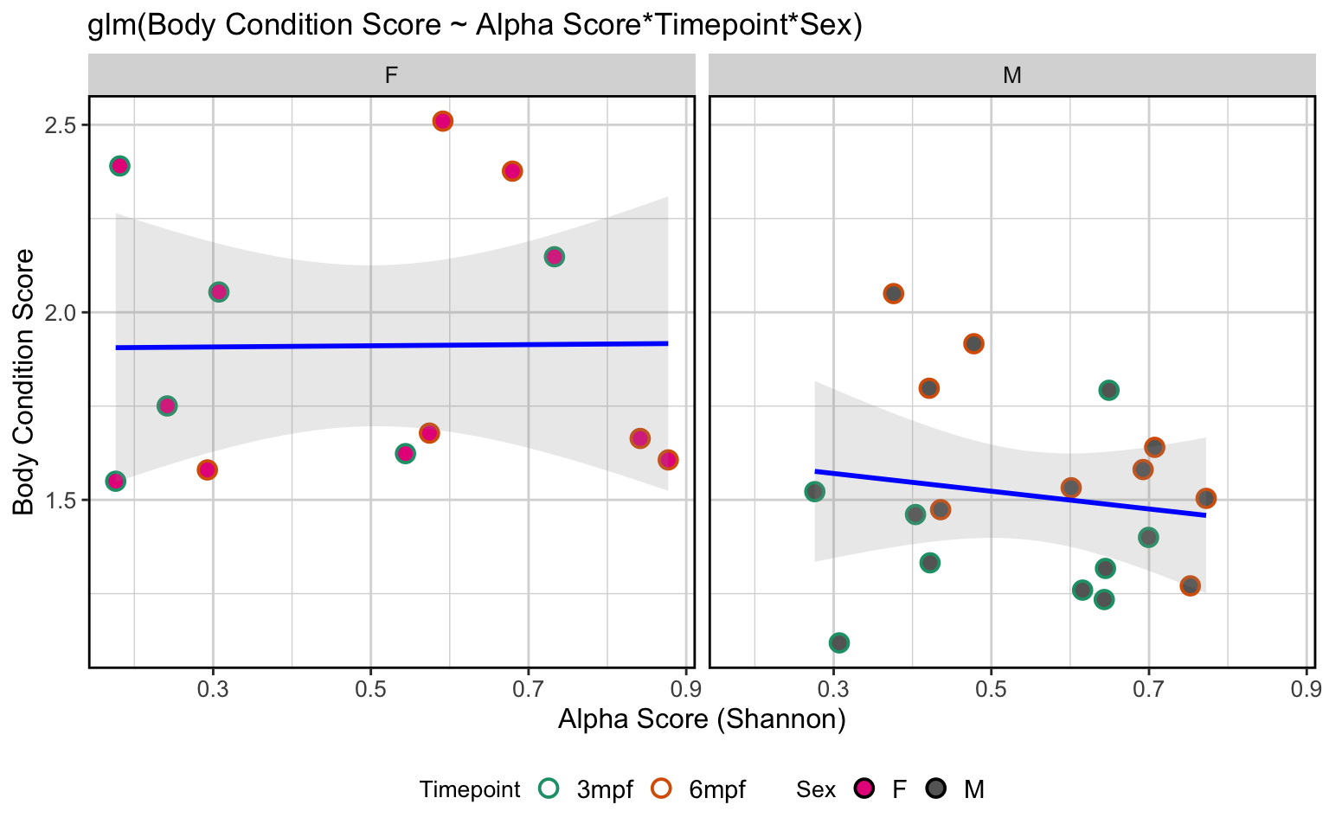
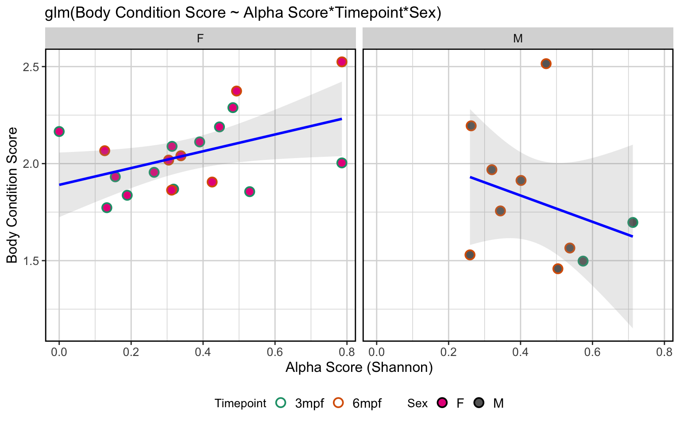
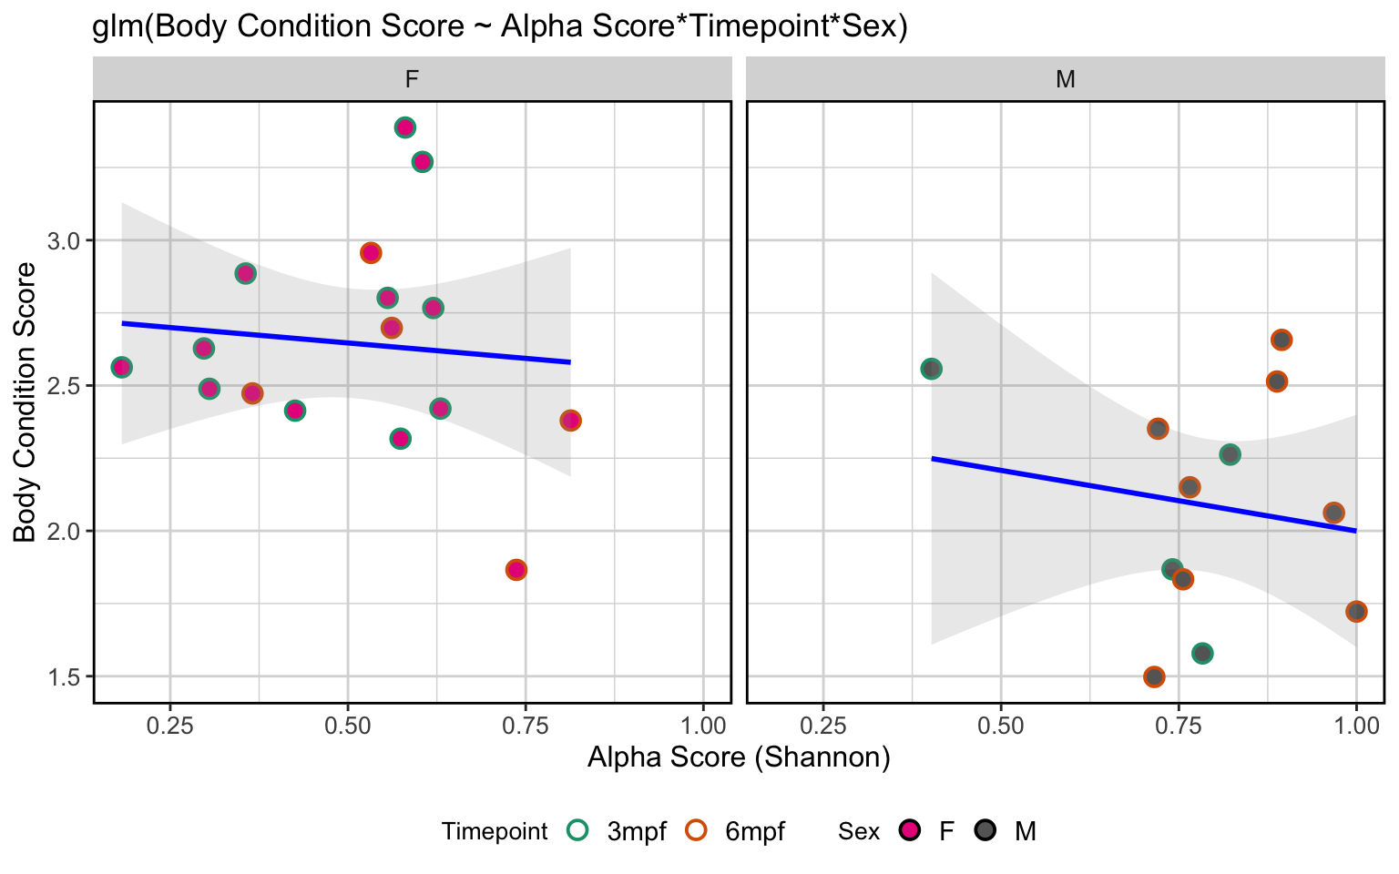
Gemma | Watts
ZIRC

Slide 22
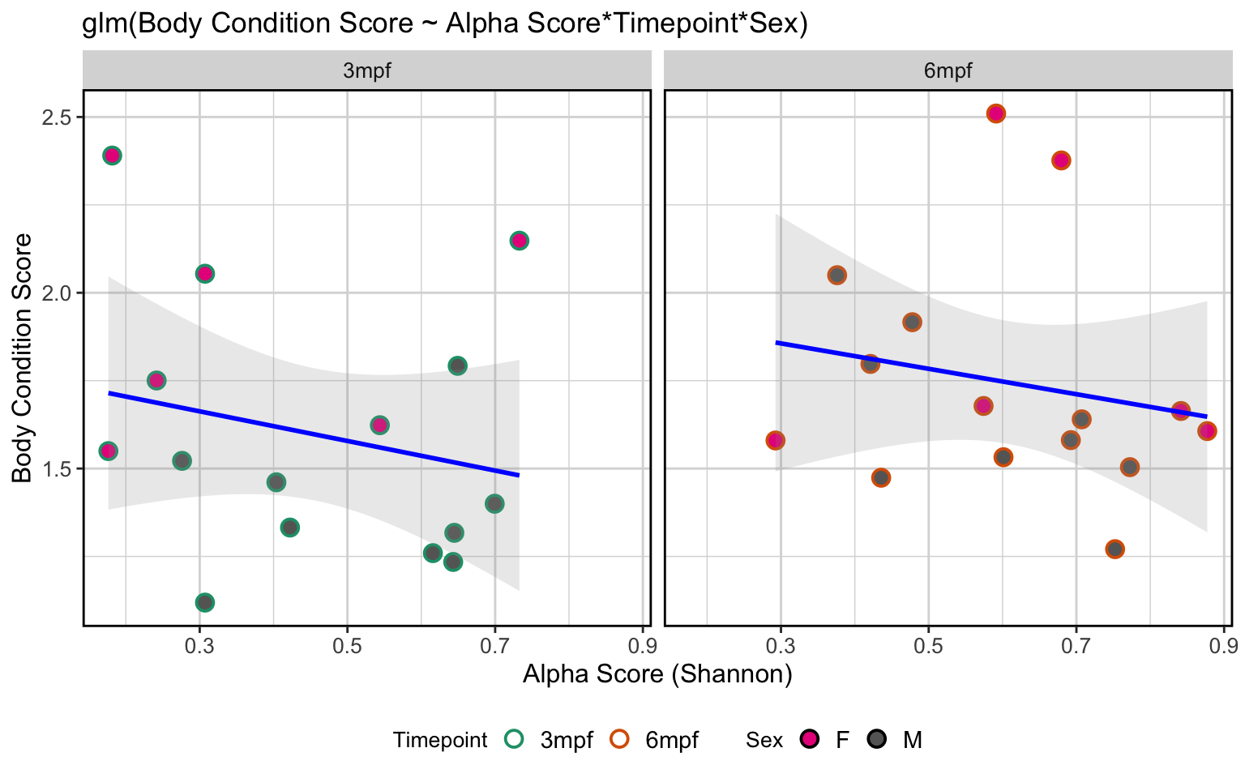
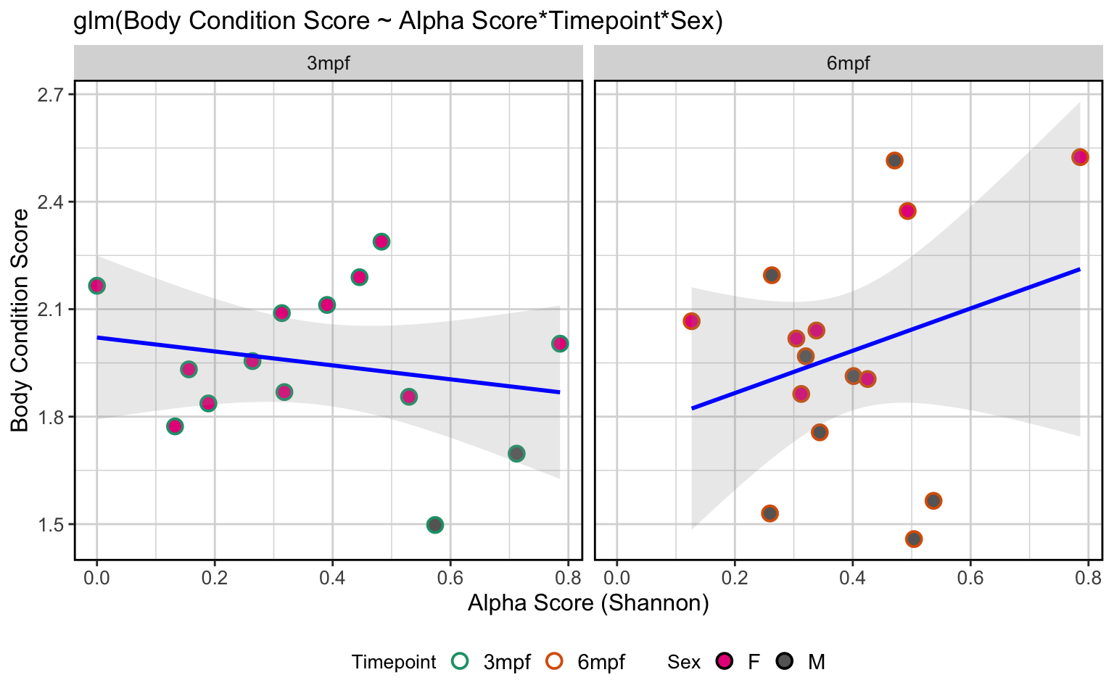
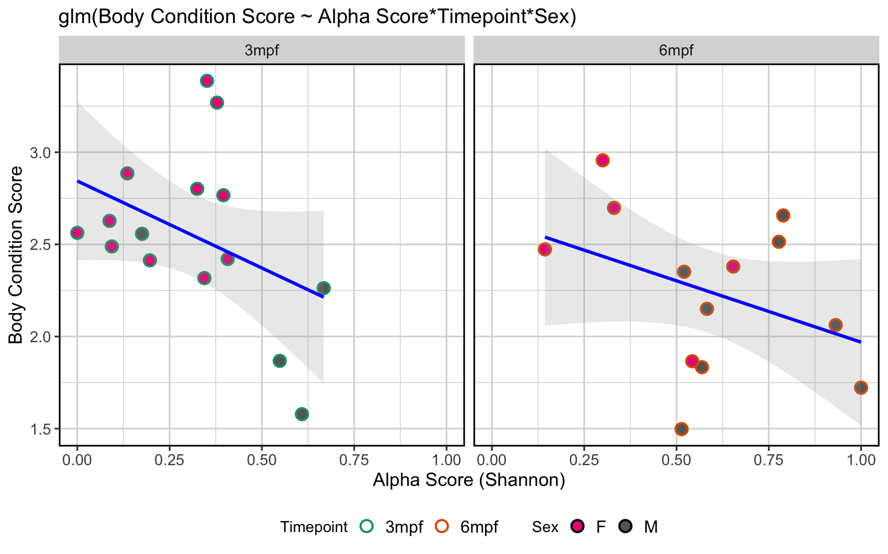
Gemma | Watts
ZIRC

Slide 23
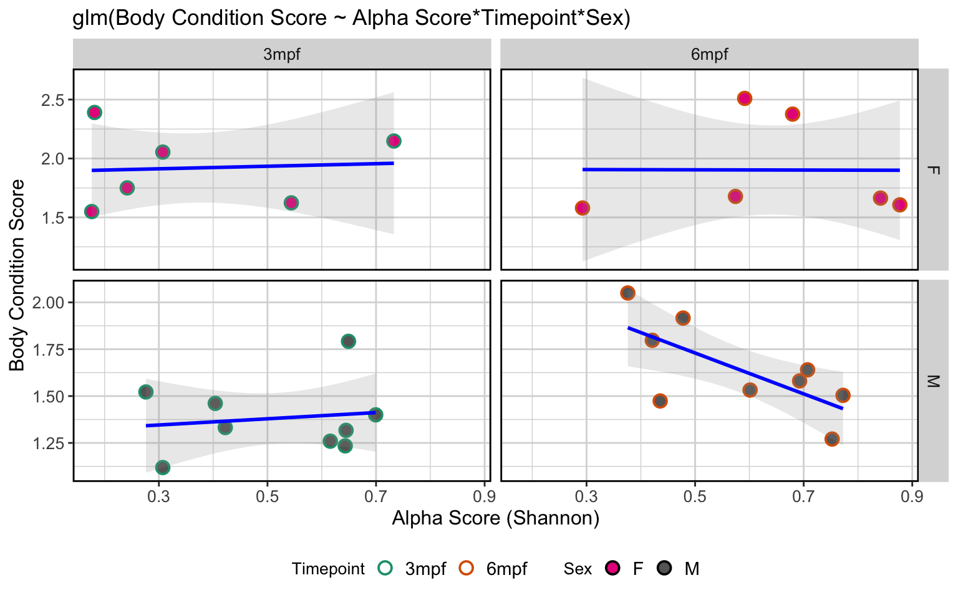
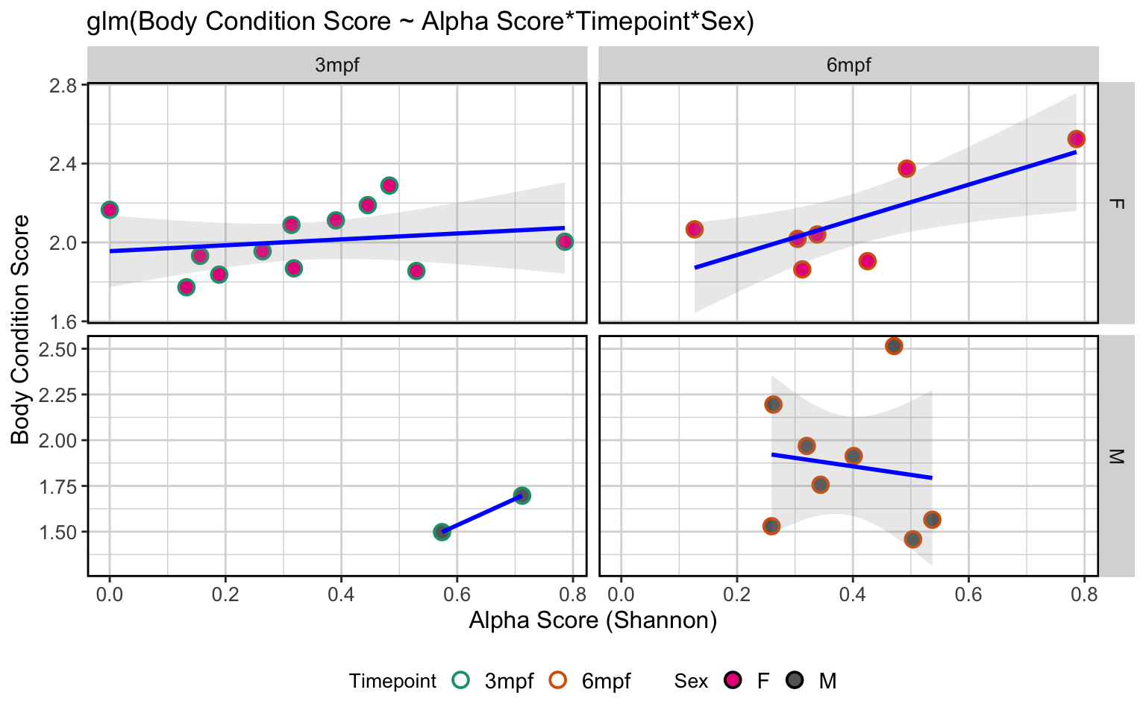
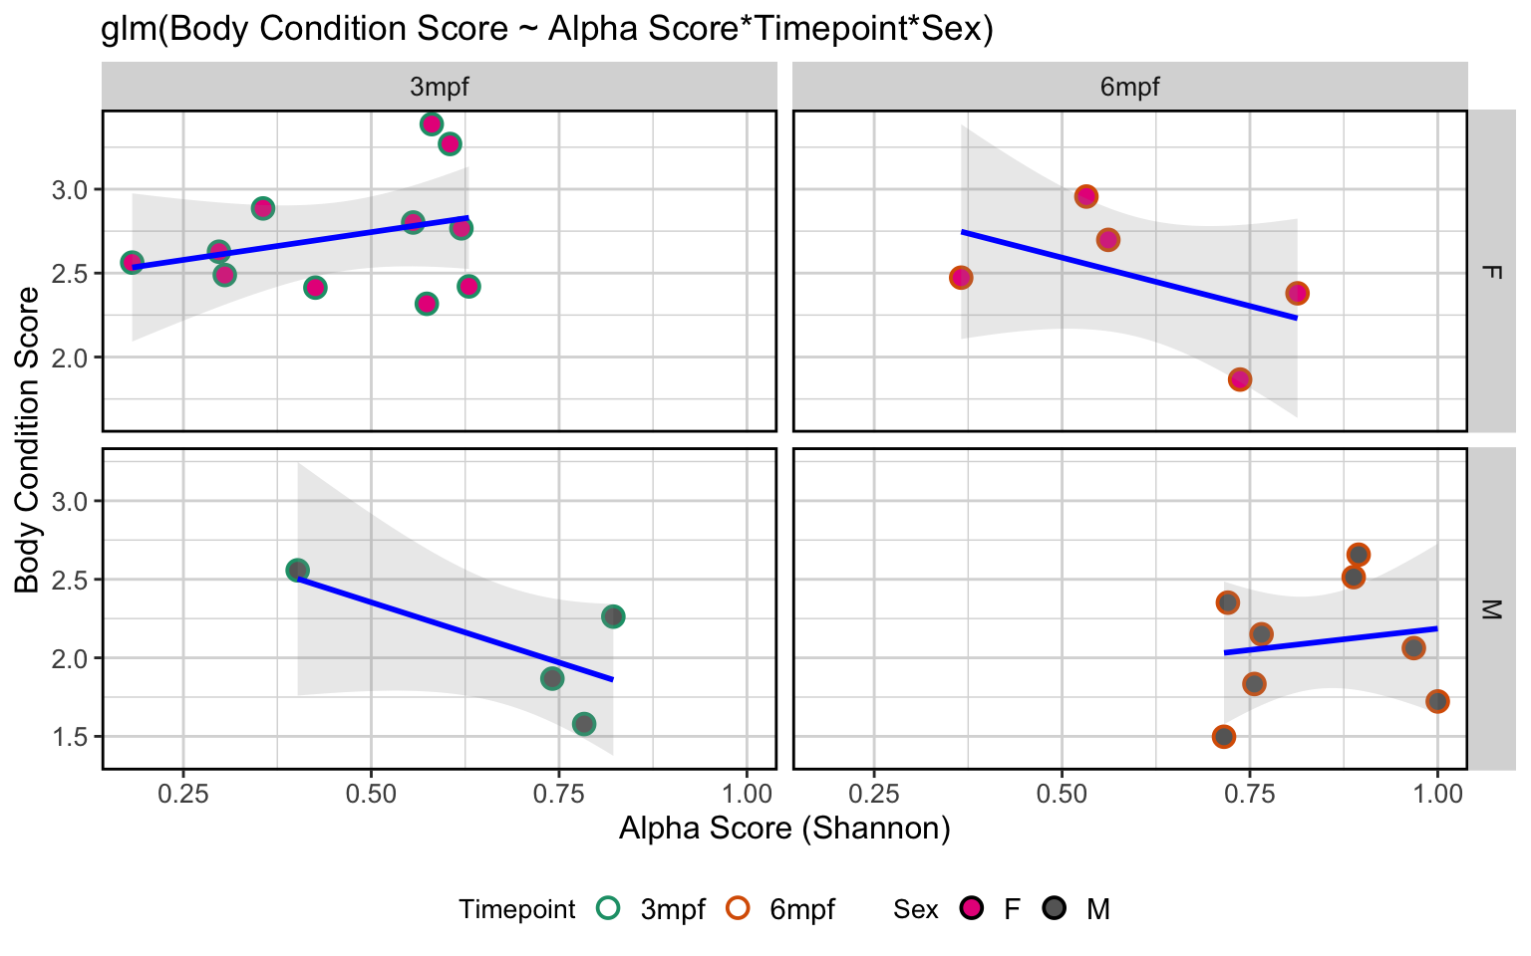
Gemma | Watts
ZIRC

Slide 24
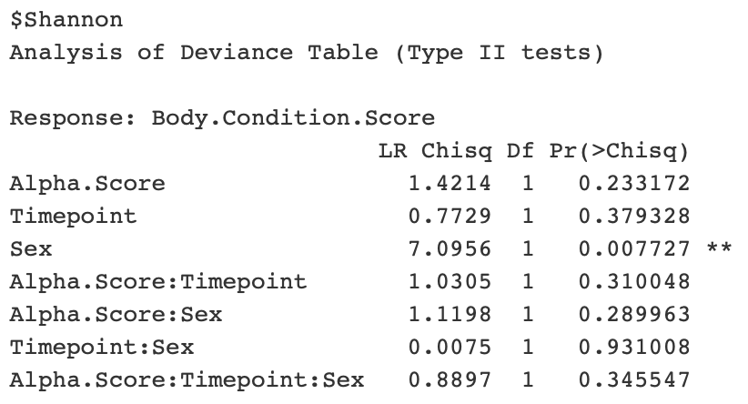
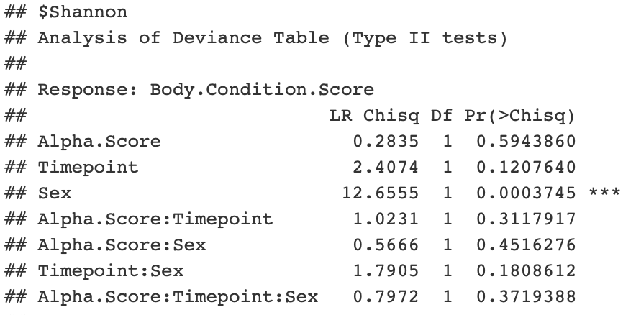
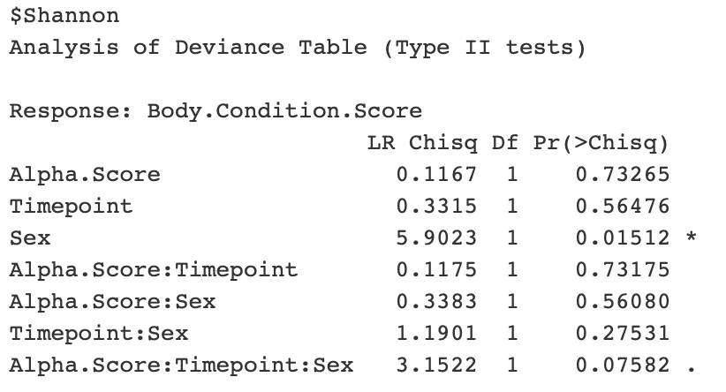
Gemma | Watts
ZIRC

Slide 25
Does the composition of the microbiome linked to diet and body condition score/level?

Slide 26
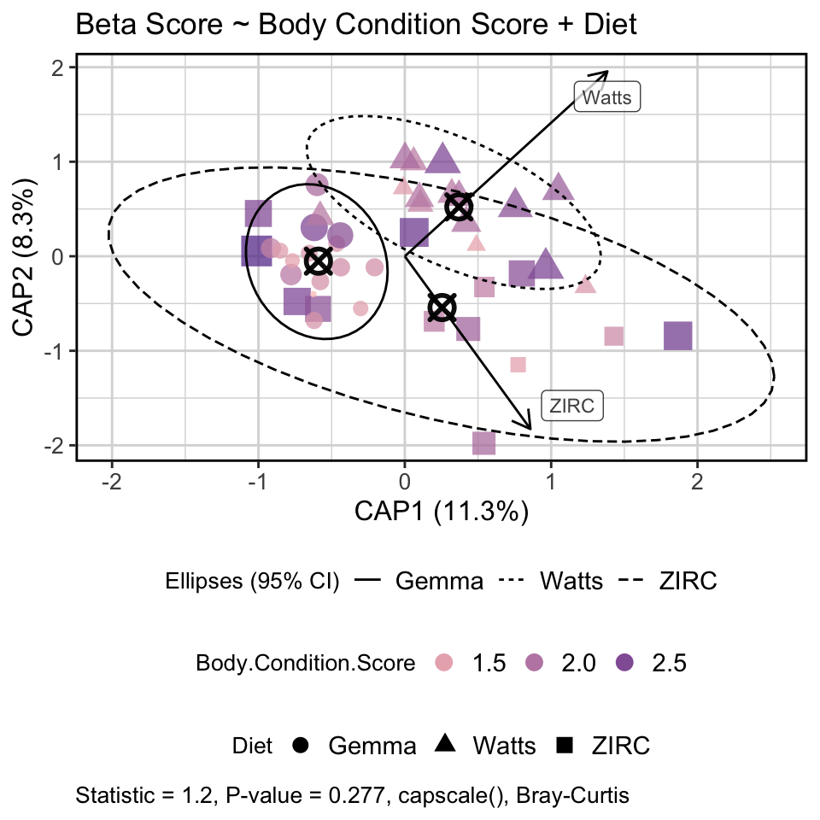
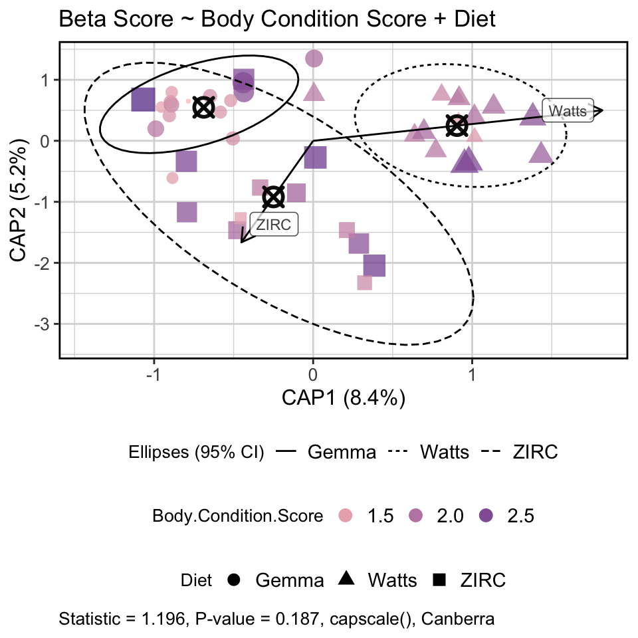
Diet is a stronger predictor of composition than body condition score
(final timepoint)
(final timepoint)

Slide 27
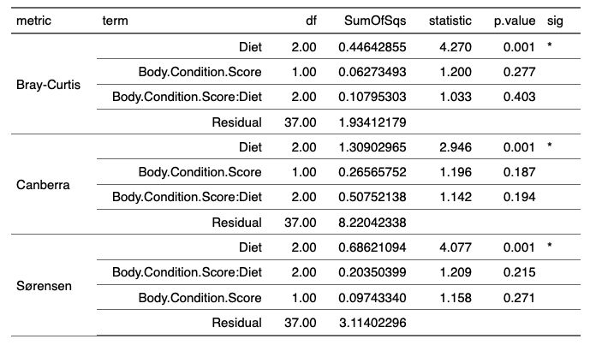

Slide 28
Does microbiome composition stratify by high and low body condition scores?

Slide 29
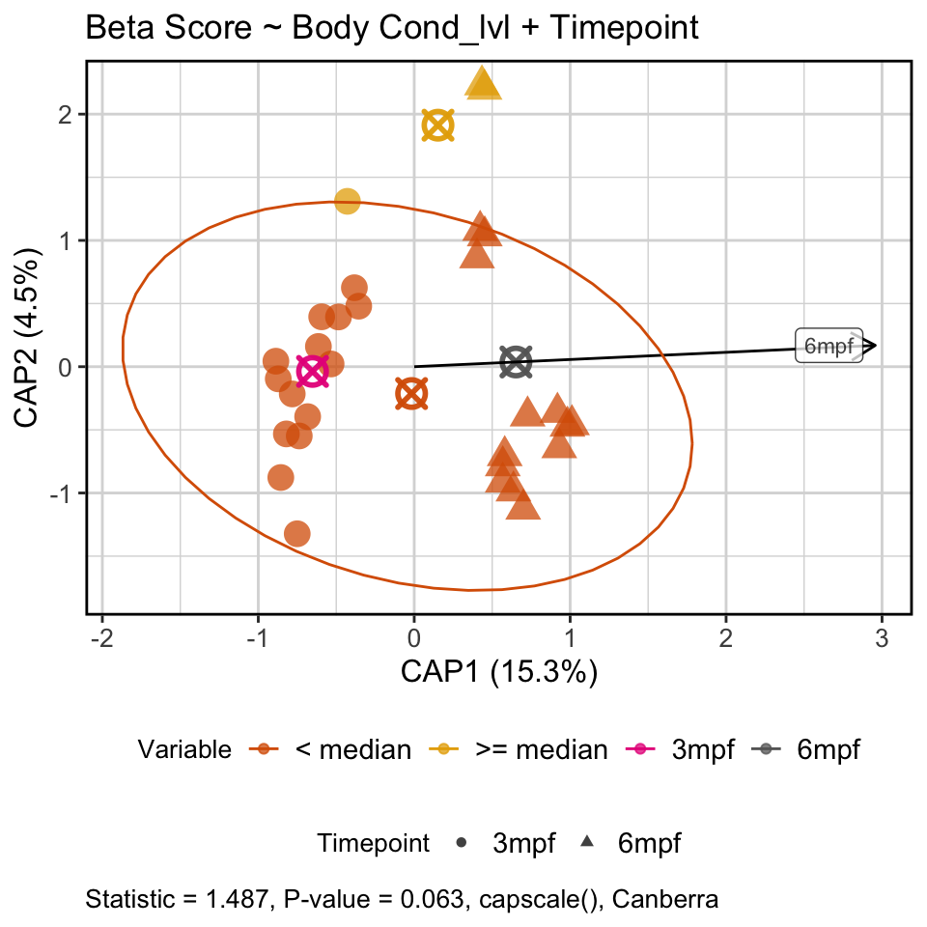
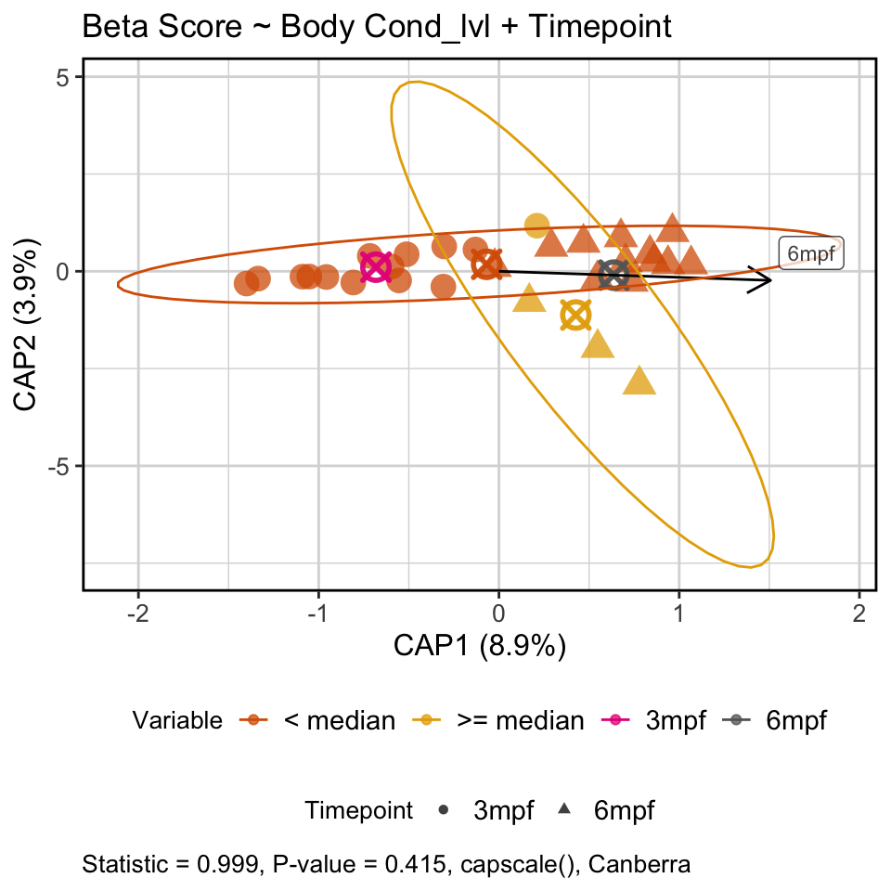
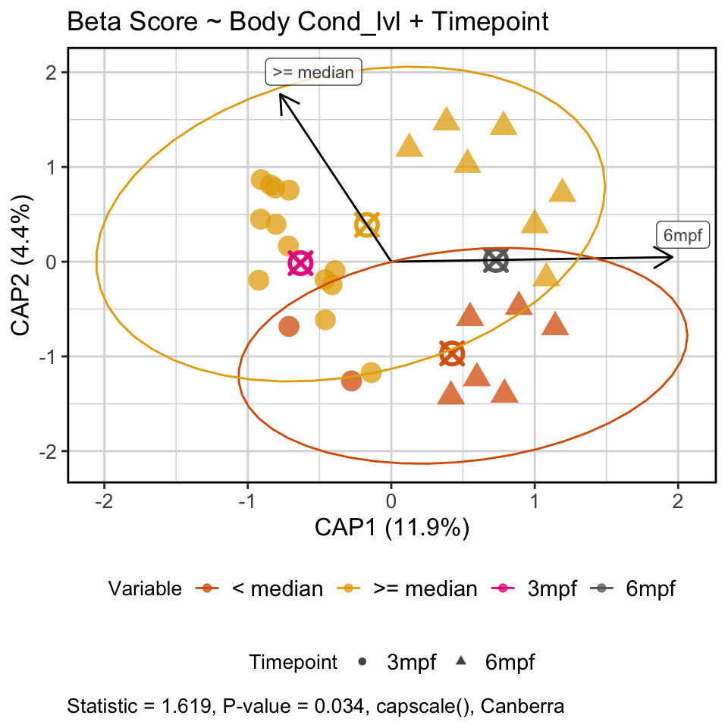
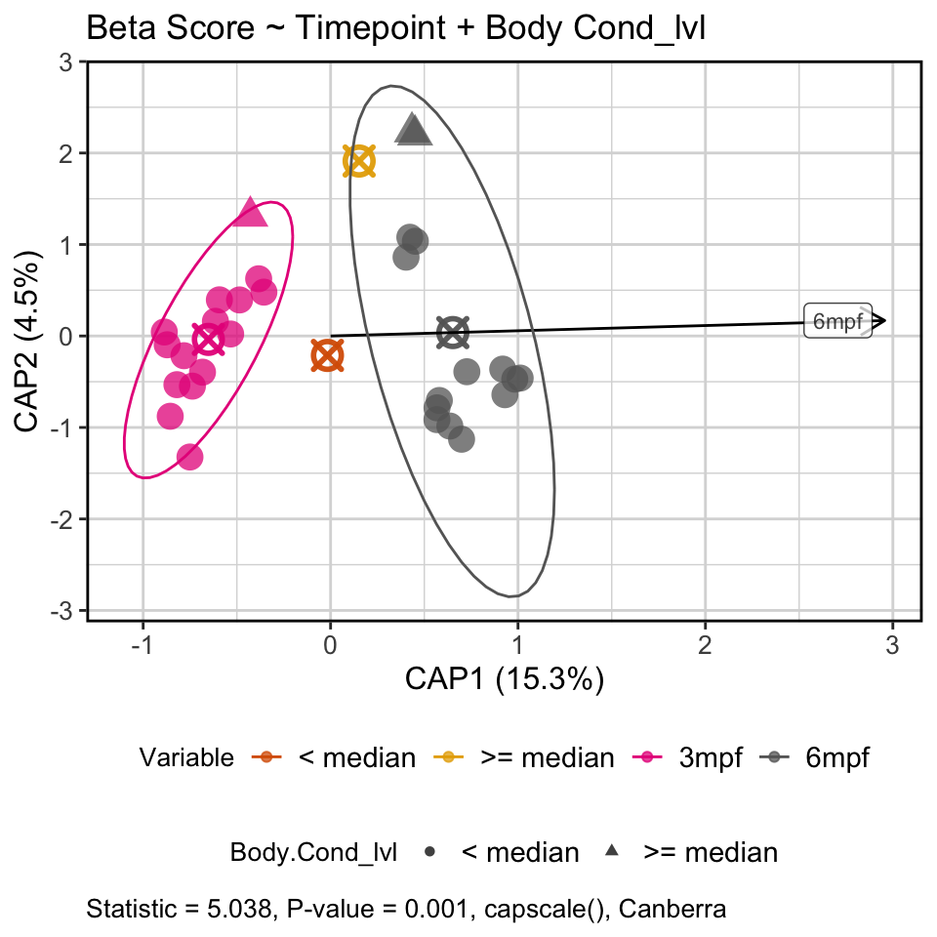
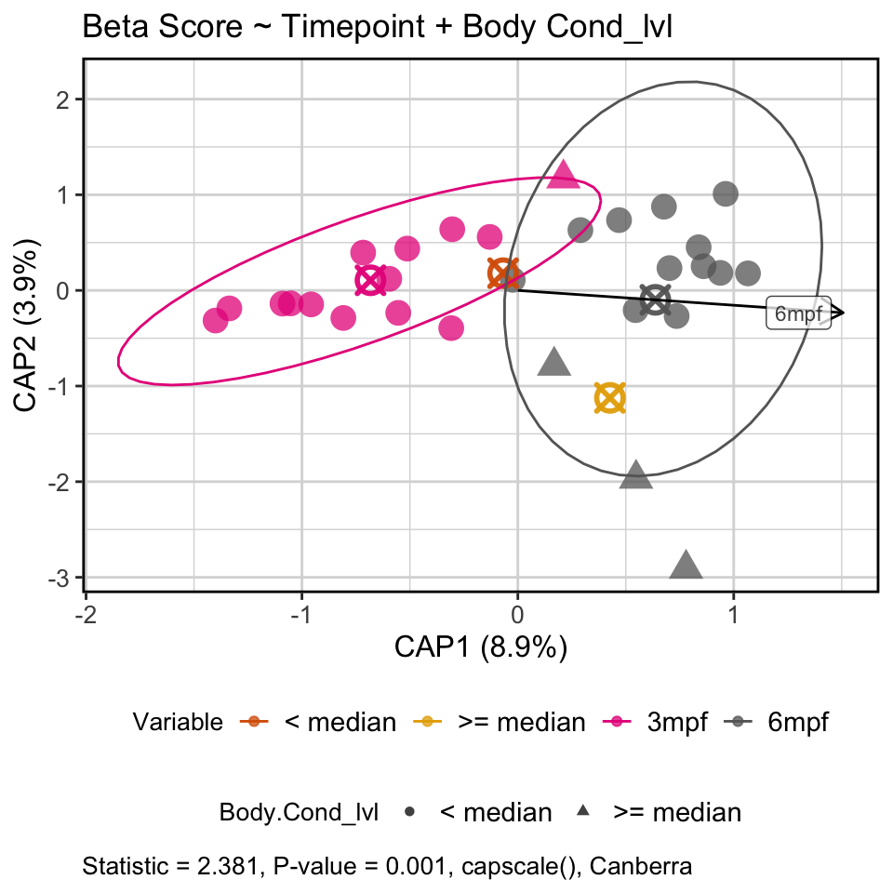
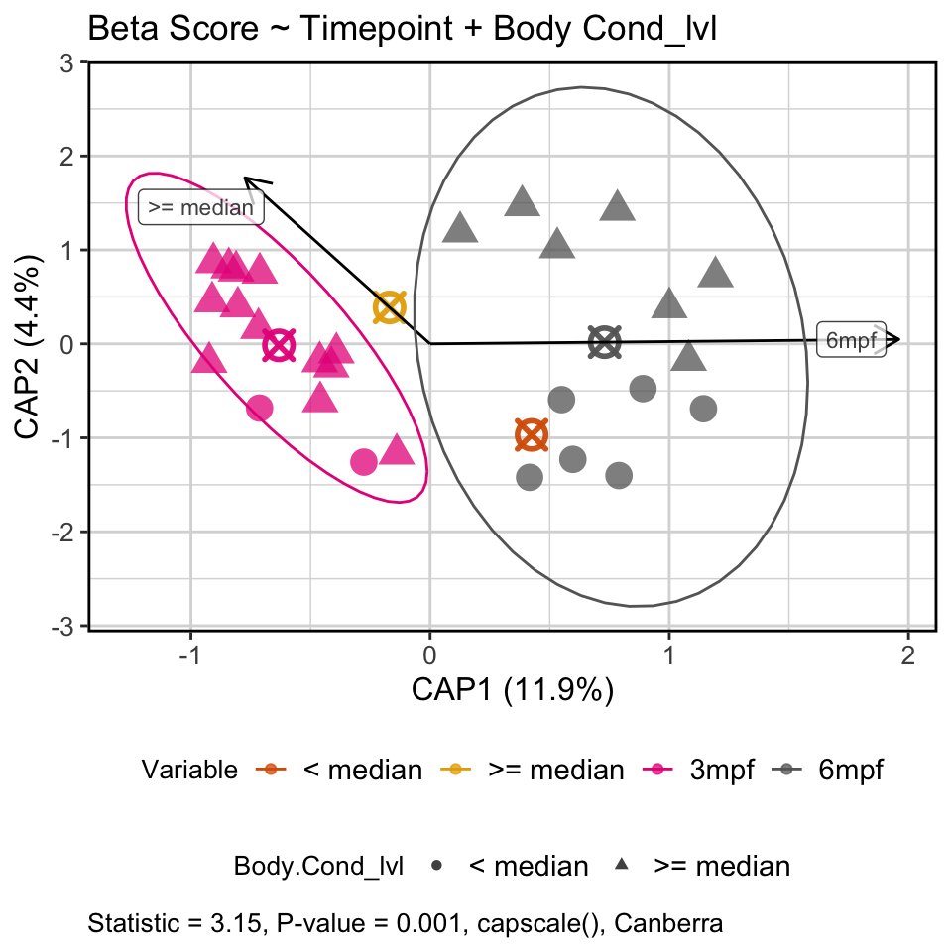
Gemma
Watts
ZIRC
BCL = 2.25
BCL = 2.25
BCL = 2.25
Gemma
Watts
ZIRC
BCL = 2.25
BCL = 2.25
BCL = 2.25

Slide 30
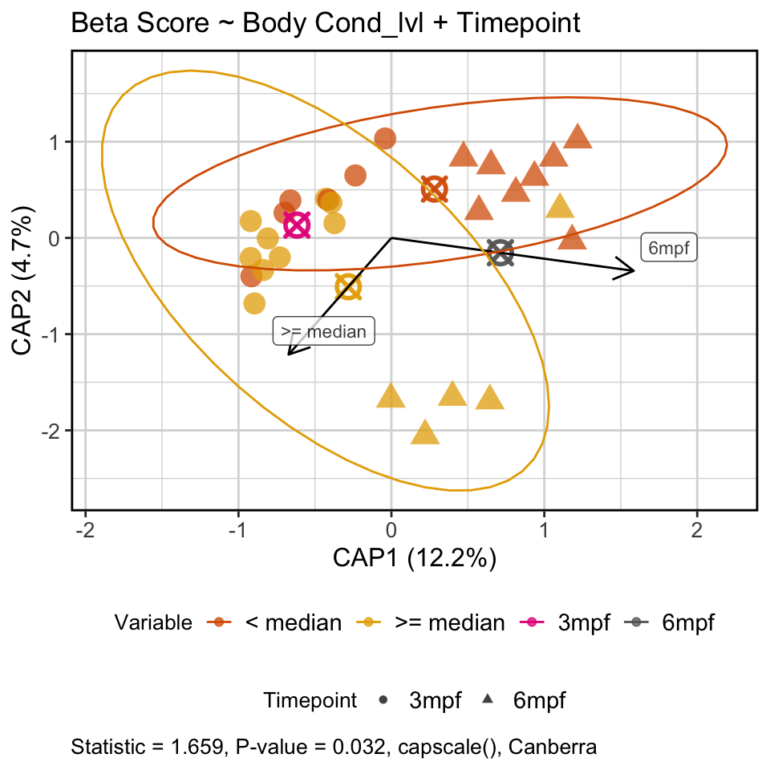
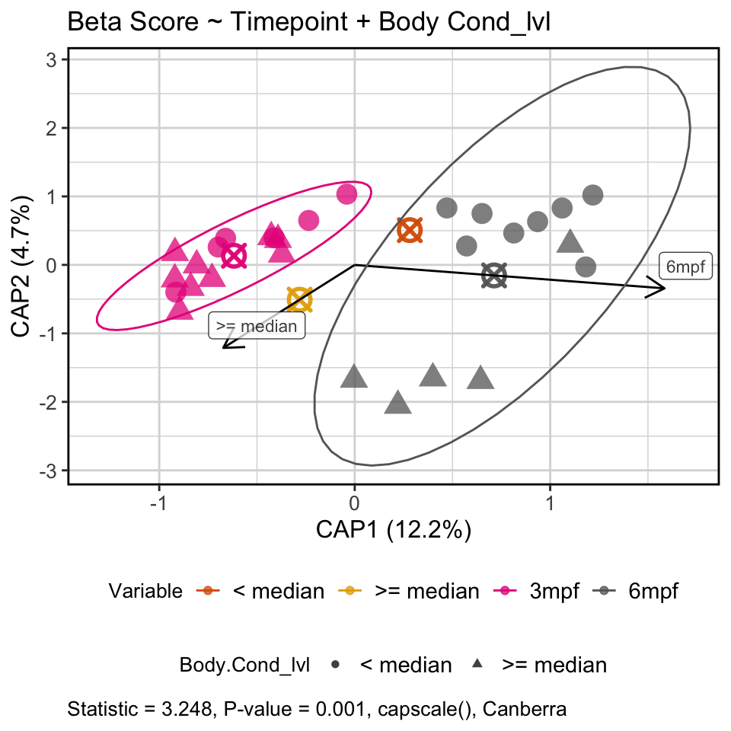
At 3 mpf the microbiome composition of ZIRC fed fish did not differ, but at 6 mpf they stratified by body condition level
BCL = 2.45
BCL = 2.45

Slide 31

ZIRC fed fish stats

Slide 32
Do certain taxa explain the diversity and compositional differences we see in body condition scores in ZIRC fed fish?

Slide 33
Differentially abundant taxa in ZIRC fed fish by body condition score across both time points

Slide 34
Differentially abundant taxa in ZIRC fed fish by body condition score at final time point

Slide 35
Differentially abundant genera found across body condition levels (2.45) and time in ZIRC fed fish

Slide 36

Aeromonas abundance decreased with body condition score across all diets

Slide 37


Slide 38
How do fish microbiomes develop over time as a function of diet and physiology?

Slide 39



Slide 40



Slide 41



Body Condition Level = 2.25
Body Condition Level = 2.25
Body Condition Level = 2.25

Slide 42


Slide 43


No difference between exposure groups within diets

Slide 44


ZIRC fed fish heaviest across all exposure groups

Slide 46
Does pathogen exposure affect microbiome?

Slide 47


Unexposed fish have higher alpha diversity compared to exposed and pre-exposed fish across all diets

Slide 48



Pathogen exposure stratifies the composition of the gut microbiome

Slide 49
Is the exposure effect on the microbiome diet dependent?

Slide 50



ZIRC is more sensitive to pathogen exposure than other diets

Slide 52



Slide 53


The influence of exposure is secondary to diet
Notes:
What’s interesting here is that exposed and unexposed (aka final timepoint, 6mpf) are overlapping in pretty much all diets. Suggesting a time effect rather than exposure for composition.

Slide 54


Notes:
What’s interesting here is that exposed and unexposed (aka final timepoint, 6mpf) are overlapping in pretty much all diets. Suggesting a time effect rather than exposure for composition.

Slide 55


Slide 56
Differentially abundant genera found across exposure groups

Slide 57
Differentially abundant genera found across exposure groups in ZIRC fed fish

